Slide 1
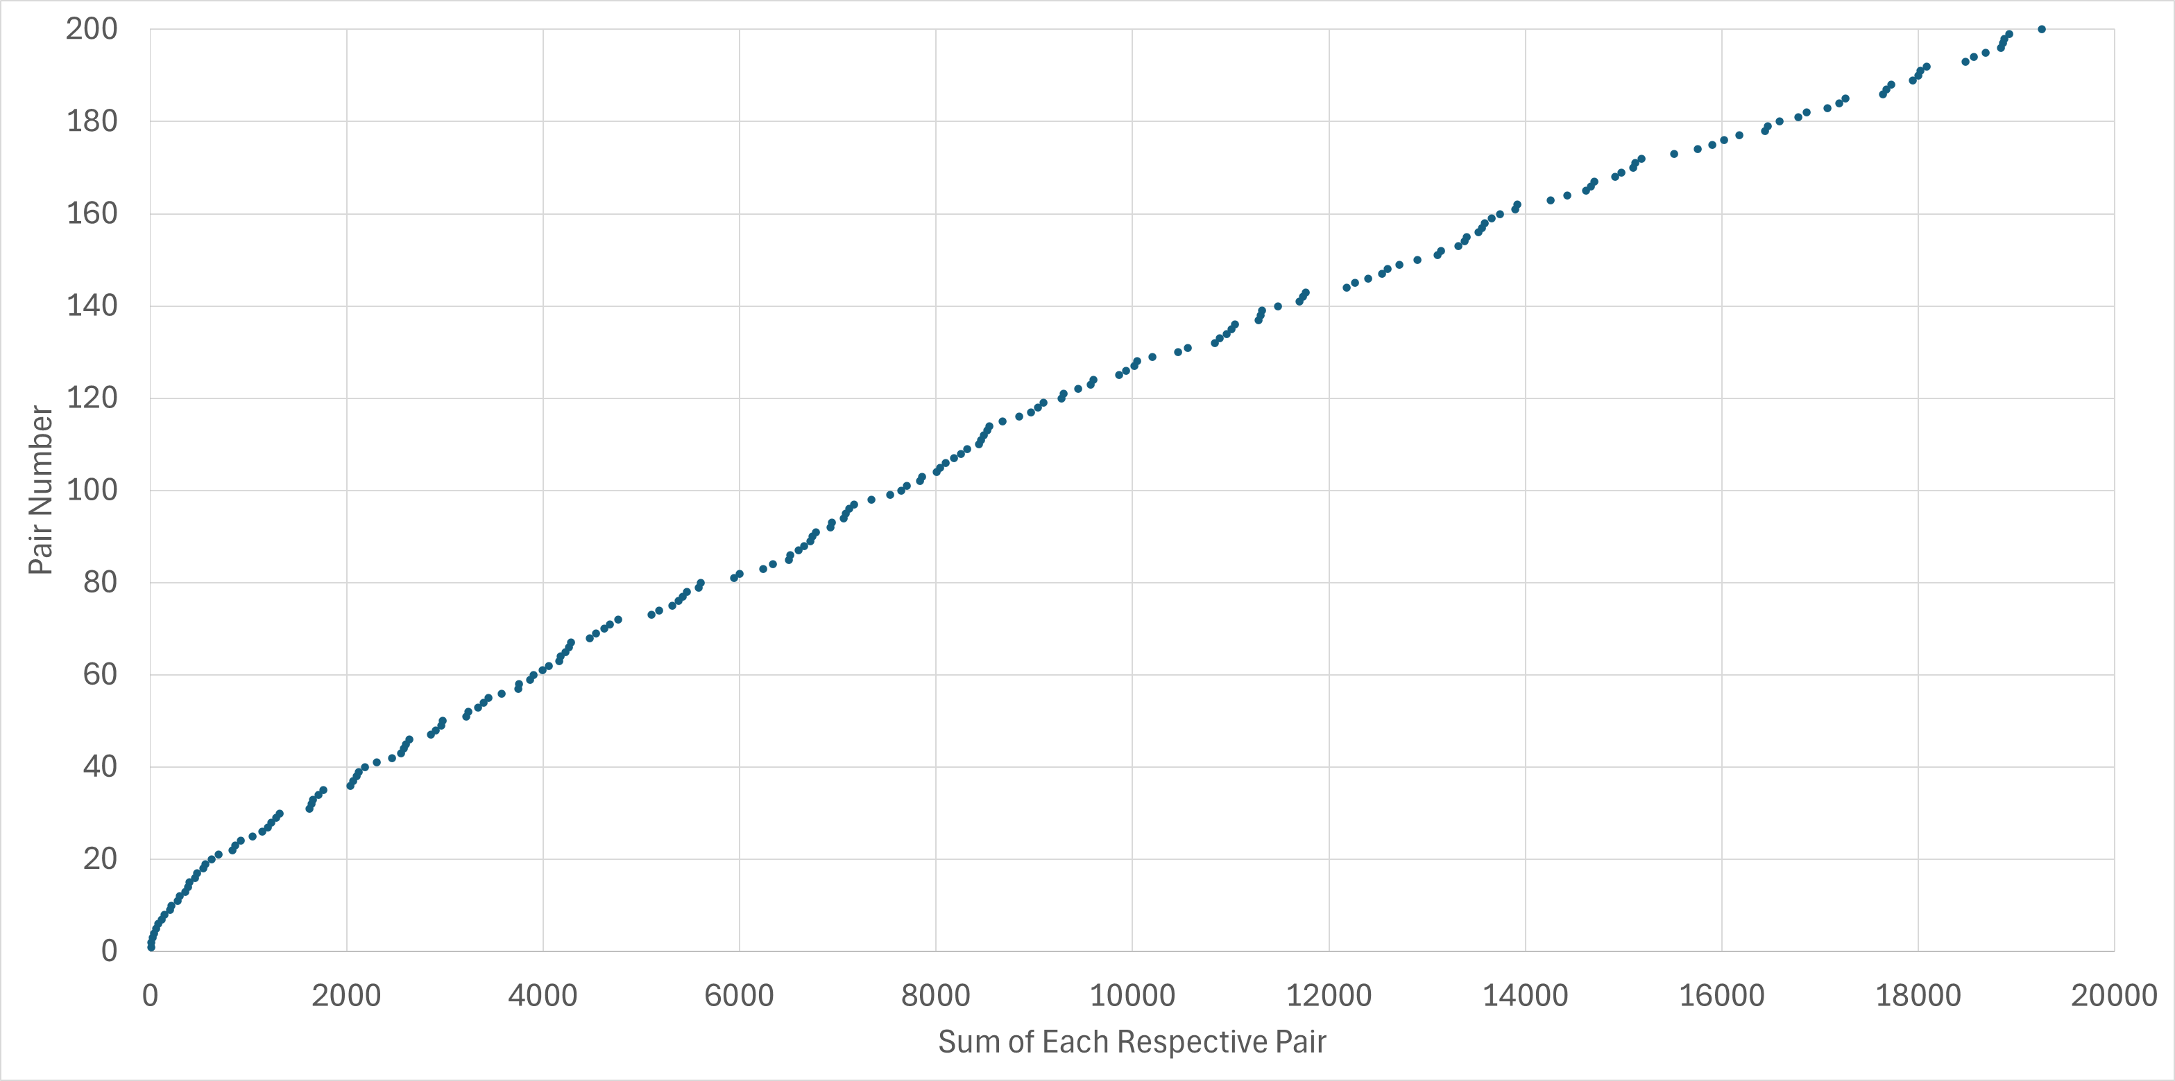
The Twin Prime Conjecture
by Daniel Jackson

Slide 2
Talk Structure:
Importance in Number Theory and Applications
History and what the twin prime conjecture states/ different forms
Some trivial properties
An introduction to Sieve Theory and Brun’s Theorem
Examples of Prime Distributions
Recent work: Yitang Zhang, James Maynard and the Polymath Project
Key points
Why mathematicians continue to attempt to work on this conjecture

Slide 3
Importance to Number Theory and Applications
Understanding the distribution of the prime numbers is fundamental to both number theory and cryptography; both hugely relevant and important topics to researchers today.
Cryptography is responsible for the encryption of most today’s information. We use prime numbers in prominent (asymmetric) cryptographical algorithms today (RSA, ECC and DSA being main examples)
A better understanding of twin primes helps mathematicians develop techniques to help solve other related problems. Both Sieve Theory and the Circle Method have either been used to understand twin primes after being developed in other fields or have been used to better understand other fields after techniques have been developed studying twin primes.

Slide 4
What is the Twin Prime Conjecture?
The Twin Prime Conjecture has been written in many different forms; however, I believe the simplest to be:
There exist infinitely many pairs of natural numbers p, p+2 such that both the numbers are prime
Some examples of twin primes would be: {3,5}, {5,7}, {11,13}, {17,19}, {101,103}, {197,199}, {99989, 99991}.
There are various ways we can check primes, known as primality tests, that we can use to check whether numbers are prime. Computers use methods to check for primes.
As of 2022, the largest known twin prime pair is
2996863034895 × 2¹²⁹⁰⁰⁰⁰ ± 1. (388342 digits)
(http://www.primegrid.com/forum_thread.php?id=7021)

Slide 5
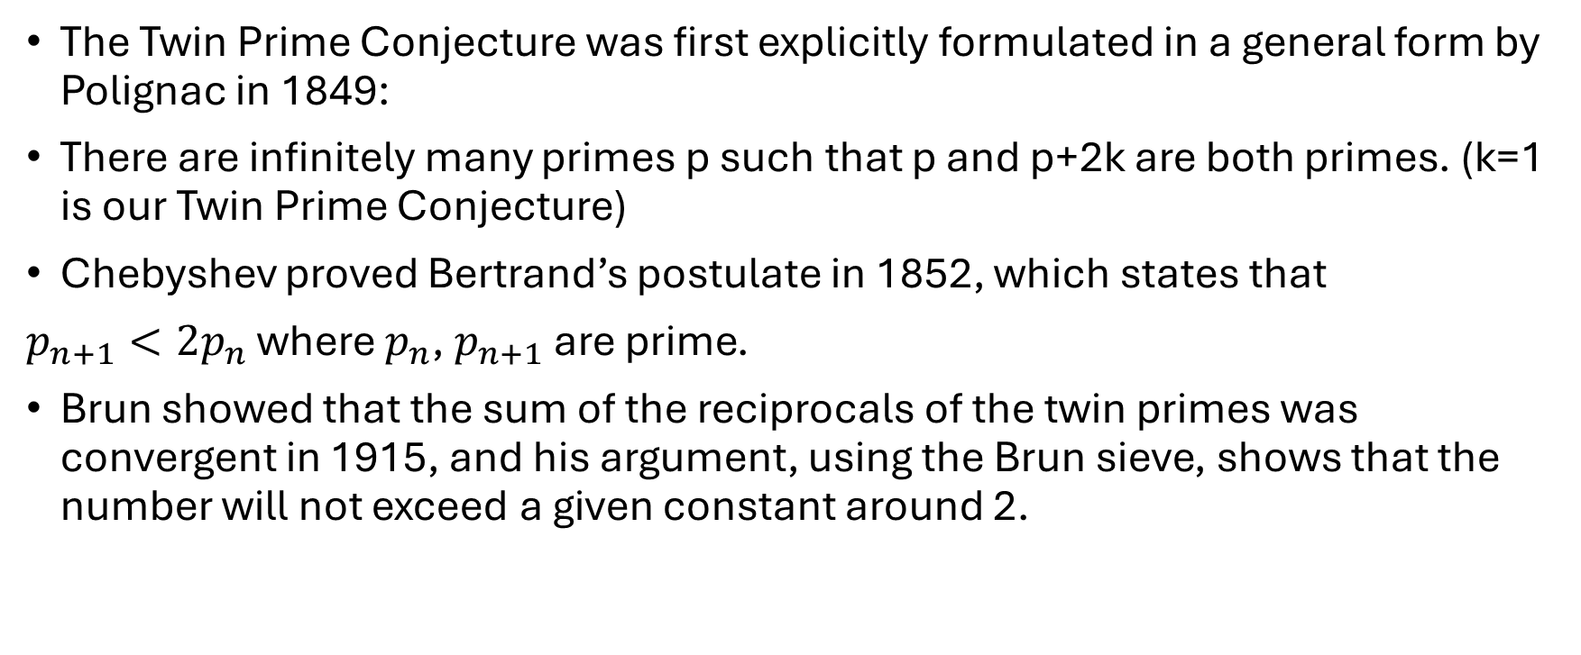
History
The Twin Prime Conjecture was first explicitly formulated in a general form by Polignac in 1849:
There are infinitely many primes p such that p and p+2k are both primes. (k=1 is our Twin Prime Conjecture)
Chebyshev proved Bertrand’s postulate in 1852, which states that
$p_{n+1}<2p_{n}$ where $p_{n}$, $p_{n+1}$ are prime.
Brun showed that the sum of the reciprocals of the twin primes was convergent in 1915, and his argument, using the Brun sieve, shows that the number will not exceed a given constant around 2.

Slide 6
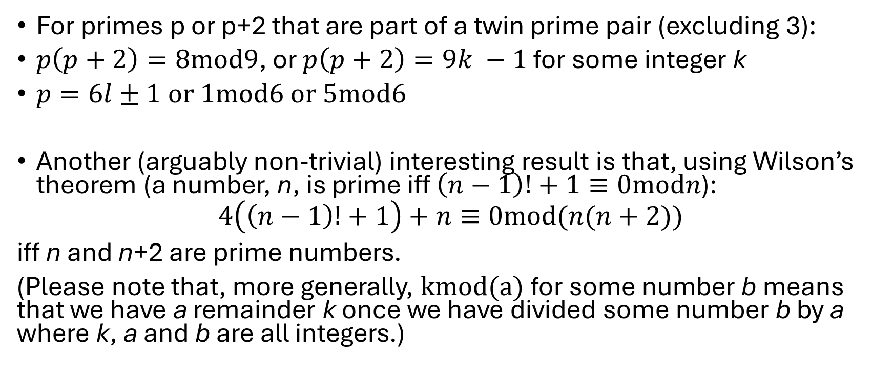
Some Trivial Properties of Twin Primes
For primes p or p+2 that are part of a twin prime pair (excluding 3):
$p\left(p+2\right)=8mod9$, or $p\left(p+2\right)=9k −1$ for some integer k
$p=6l±1$ or $1mod6$ or $5mod6$
Another (arguably non-trivial) interesting result is that, using Wilson’s theorem (a number, n, is prime iff $\left(n−1\right)!+1≡0modn$):
$$4\left(\left(n−1\right)!+1\right)+n≡0mod(n(n+2))$$
iff n and n+2 are prime numbers.
(Please note that, more generally, kmod(a) for some number b means that we have a remainder k once we have divided some number b by a where k, a and b are all integers.)

Slide 7
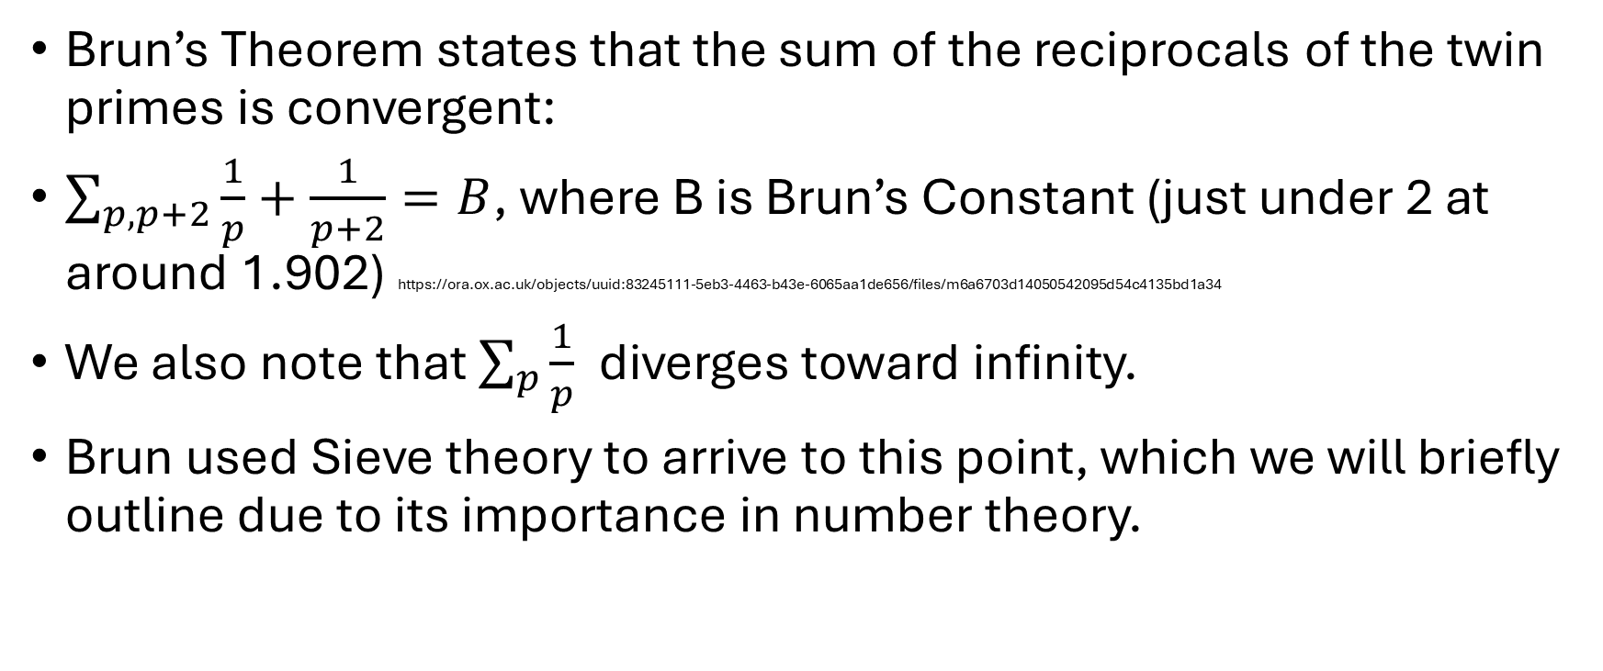
Brun’s Theorem and Sieve Theory
Brun’s Theorem states that the sum of the reciprocals of the twin primes is convergent:
$\sum_{p,p+2}{\frac{1}{p}+\frac{1}{p+2}=B}$, where B is Brun’s Constant (just under 2 at around 1.902) https://ora.ox.ac.uk/objects/uuid:83245111-5eb3-4463-b43e-6065aa1de656/files/m6a6703d14050542095d54c4135bd1a34
We also note that $\sum_{p}{\frac{1}{p}}$ diverges toward infinity.
Brun used Sieve theory to arrive to this point, which we will briefly outline due to its importance in number theory.

Slide 8
Sieve Theory
Sieve Theory is useful in many fields; examples including self-avoiding walks and cyclic structures in group theory however happens to be exceptionally useful when better understanding prime numbers
Generally, it concerns objects which are the output of some inclusion-exclusion process
Sieve Theory’s nature involves abandoning some level of structure in favour of approximations, allowing partial information to be obtained such as bounds. It serves normally as one of the first steps to forming an argument when proving prime number related theorems
We will look briefly at the Sieve of Eratosthenes (a mathematician born in 276BC) from numbers up to 100 to illustrate this.

Slide 9
“The Sieve of Eratosthenes identifies all the primes less than a given number, in this case 121. It starts with the first prime — two, coloured bright red — and eliminates all numbers divisible by two (coloured dull red). Then it moves on to three (bright green) and eliminates all multiples of three (dull green). Four has already been eliminated, so next comes five (bright blue); the sieve eliminates all multiples of five (dull blue). It moves on to the next uncoloured number, seven, and eliminates its multiples (dull yellow). The sieve would go on to 11 — the square root of 121 — but it can stop here, because all the non-primes bigger than 11 have already been filtered out. All the remaining numbers (coloured purple) are primes.” (The caption from Quanta Magazine outlining how this sieve works)
This sieve does an excellent (perfect) job at identifying primes, though it is a slow process. What mathematicians do instead is devise less precise methods that are less cumbersome, though more useful for answering theoretical ideas.
https://www.quantamagazine.org/yitang-zhang-proves-landmark-theorem-in-distribution-of-prime-numbers-20130519/

Slide 10
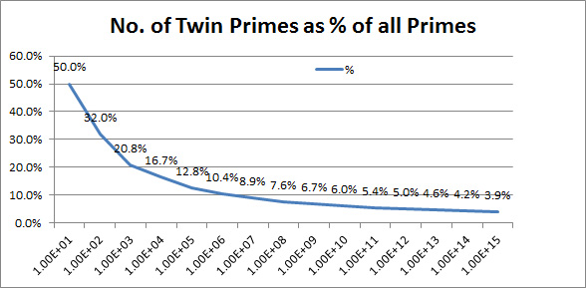
Distributions of primes/some data on twin primes
https://www.hugin.com.au/prime/abouttwin.htm
We can see that the number of twin primes becomes an increasingly smaller fraction of the prime numbers as we approach very large integers. This again does not mean that there are finitely many twin prime numbers.
I wrote a python script from a data set I found of the first 20,000 twin prime pairs and compared it graphically against the first 40000 primes in 2 separate ways using NumPy and Matplotlib. The graphs are shown on the next 2 slides.

Slide 11
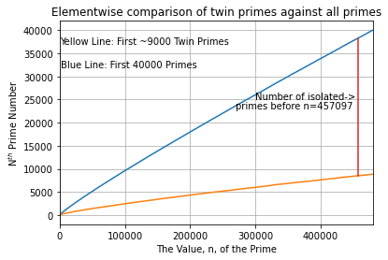
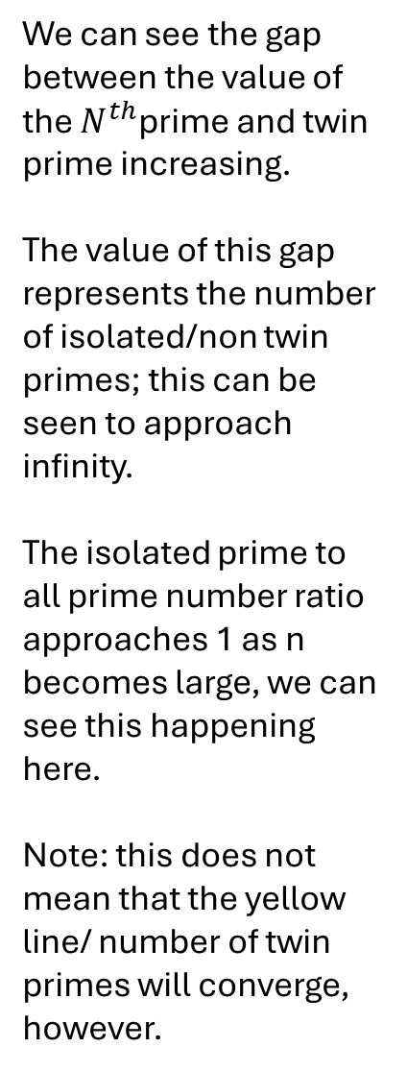
Isolated Primes and Twin Primes
We can see the gap between the value of the $N^{th}$prime and twin prime increasing.
The value of this gap represents the number of isolated/non twin primes; this can be seen to approach infinity.
The isolated prime to all prime number ratio approaches 1 as n becomes large, we can see this happening here.
Note: this does not mean that the yellow line/ number of twin primes will converge, however.

Slide 12
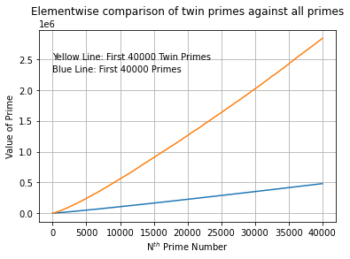

Slide 13
Recent Developments
More recently in April 2013 we have seen Yitang Zhang prove that for some integer N less than 70 million, there exist infinitely pairs of primes p such that p and p+N are both prime (Polignac’s conjecture for some k=N). Terrence Tao subsequently announced a polymath project to improve this gap to a smaller N
Following the Polymath project in 2014, James Maynard and Tao independently discovered a method to optimise this gap to 246, however assuming a conjecture that concerns the distribution of primes in arithmetic progressions this gap can be optimised to, at best, 6. This is arguably the closest we have got to proving the twin prime conjecture since it was proposed.

Slide 14
Key Points
Any twin prime will be either 1 more than or 1 less than a multiple of six, and a twin prime pair’s product will always be one less than a multiple of 9.
Whilst we cannot yet prove the desired conjecture, we can show that Polignac’s conjecture is true for k=246
The largest known twin prime pair is
2996863034895 × 2¹²⁹⁰⁰⁰⁰ ± 1. (388342 digits)
Sieve Theory is crucial to better understanding twin primes and was used by Zhang, Tao and Maynard to help make the progress that has been made this century.
If we plot a graph of the number of twin primes against the numbers where they appear and approximate the graph as a curve, we see a negative second derivative in gradient but a positive first derivative. If the twin prime conjecture is true, the graph will never have a negative first derivative.

